Slide 1
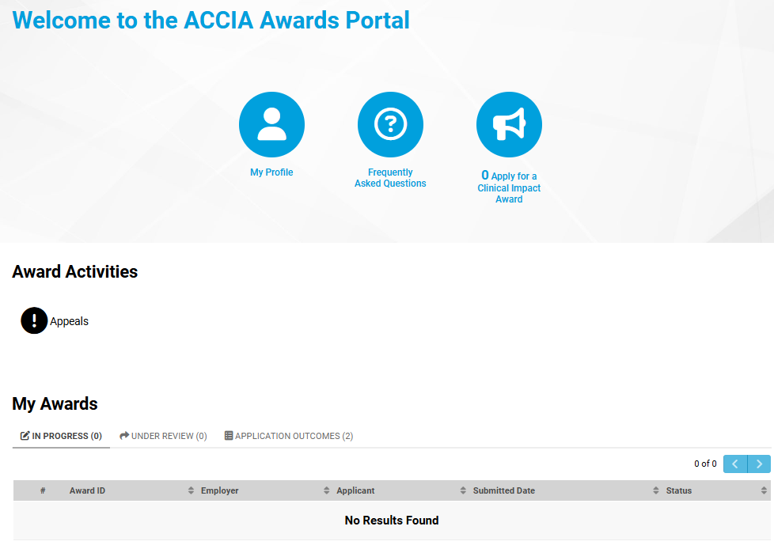

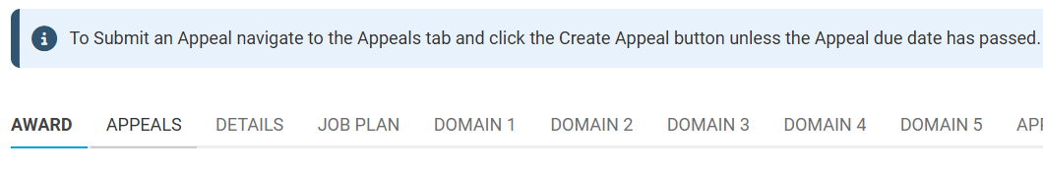
Accessing your NCIA outcome letter
1. When you login, you may need to scroll down from the blue icons to find the “My Awards” section
2. Click on the “Application outcomes” tab, here you will see all applications you have submitted via the portal
3. Once you have clicked through to your application, you once again may need to scroll down to see the “Download letter” button – this may be a file name instead, depending on your account settings
4. If you wish to consider submitting a request to appeal the outcome of your application, please read our appeal guidance first and contact accia@dhsc.gov.uk if you need any further information.
Appeal requests can be submitted via your application, using the “Appeals” tab and following the prompts

